Slide 1
Workbook Sustainable Result (income)/Terminal Value
Internal Use Only
April 2017
EXCEL FILE:

Slide 2
Disclaimer
The content of this workbook has been produced by KPMG Germany/Deal Advisory on the basis of German accounting standards and/or IFRS, as well as considering KPMG Germany’s firm and country requirements, regulations, processes, policies and best practices. Please check your local accounting and other requirements before applying the content.

Slide 3
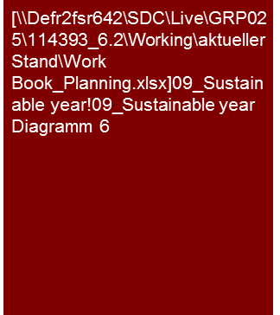
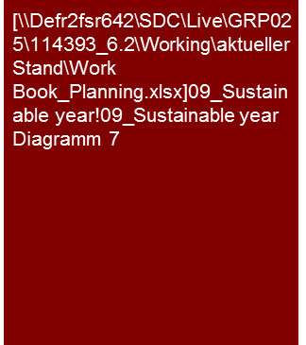
Overview (1/4) – Mission statement
Flag: Analysis Toolbox and K-Reinvest are specific tools used in Germany for valuation practice and they are not available globally.
Benchmarking Plus tool is available in Germany. Please ask for benchmarking options in your region.
Sustainable Result (income)/Terminal Value
Mission Statement:
Assessment of the sustainable, long-term average attainable level of cash flow
Customer situation
Definition/Methodology/Tools of the basis analysis
Buy Side/Sell Side/JV
Main driver for the assessment and therefore, if applicable determining the purchase price, determination of percentage of holdings
Compare going concern with a possible exit
Turnaround
Level of result after implementation of restructuring
Cyclical company
Definition
The terminal value reproduces the attainable level of results in a long-term average under consideration of economic cycles, product life cycles, growth rates, etc.
Methodology
Discussion with planning responsible persons
Obligatory linkage of the knowledge from the past analysis, the market and competitive analysis and the planning analysis for the determination of the terminal value
Result of the last planning year may be the starting point, but not the predefined endpoint of the considerations
Concentration on cash-effective earnings/expenditures, for non-cash-effective earnings/expenditures assure the concurrence with the balance sheet
In accordance with the appropriateness and data situation, in some cases the analysis and/or presentation is performed at the corresponding level (e.g. Group, legal entity, segment, profit center, product group, etc.)
Tools
K-Reinvest for derivation of sustainable reinvestment rate
Young (growth) company
Degree of standardization
Analysis Toolbox (e.g. K-Reinvest)
Determination and collection of sector specific KPIs (Benchmarking Plus)

Slide 4
Overview (2/4) – Flow chart
Sustainable Result (income)/Terminal Value
Derivation of terminal value/perpetual annuity
Does the operating result/ earnings for the last planning year already represent a sustainable achievable level of earnings?
Yes
No
Cyclic company
(Young) growth company
Company with temporary advantage (e.g. excess returns)
Company with temporary disadvantage (e.g. reorganization)
Orientation of the sustainable operative result on the last planning year
Formation of average under consideration of cycles and trends
Use of the rough planning phase for transition to a sustainable operative result
Market growth
Market share
Capacities
Investments
Peer group
Margins
Working capital
etc.
Determination of the sustainable financing structure and conditions
Determination of the sustainable tax consequences
Determination of the sustainable retention requirements
Derivation of the sustainable balance sheet structure

Slide 5
Overview (3/4) – Pitfalls
Sustainable Result (income)/Terminal Value
No. | Pitfalls/Lessons learned
 | Importance of the last planning year: Only business plans with very stable business models present a steady state at the end of the planning horizon. In view of this, the last planning year does not have a favored role in the derivation of the terminal value. A simple continuation of the last planning year as terminal value should therefore be avoided. Depending on the degree of ambitiousness of the planning calculation, the cycle of the business model and the future expected corporate development, the terminal value may be below the result of the last planning year.
 | Sustainable balance sheet: Terminal value parameters require corresponding balance sheet parameters (e.g. dependent on the working capital of sales and costs of materials). Adjustments of the sustainable P&L are therefore always accompanied by adjustments of the sustainable balance sheet parameters.
 | Technical TV year: Because the sustainable cash flow derivation refers back to the sustainable year and previous year (here the last planning year), all of the effects resulting from the adjustments of the terminal value such as financing effects are not completely recorded. In view of this, the use of a so-called technical TV year is offered that leads over to the actual TV year.
 | Sustainable growth: The determination of sustainable balance sheet items based on the balance sheet items of the technical TV (these correspond to the terminal value parameters see 2) is always to be performed under consideration of the sustainable growth rate (company specific inflation rate).
 | Sustainable level of reinvestment: Especially in strongly growing companies the sustainable level of reinvestment is to be coordinated with the sustainable (if necessary also fictitious) income distributed. If a so-called fictitious complete distribution is reproduced in the TV, the level of reinvestment is to be determined only on the basis of the existing assets and the inflation and may, subsequently, be below the investments actually made in the planning period to attain the higher operative growth (only reinvestments, no expansion investments). In companies with longer investment cycles, an average investment over the entire cycle is to be considered in determining the reinvestment rate. The time of the next investment is to be considered in the derivation.
 | Special values: Particular circumstance that reach beyond the planning horizon such as tax losses carried forward, temporarily advantageous/ disadvantageous contracts, etc. are also to be considered separately as special values or alternatively on the basis of an annuity in the TV.
1
2
3
4
5
6

Slide 6






Overview (4/4) – Core issues
Flag: K-Reinvest is a specific tool used in Germany for valuation practice and it is not available globally.
Sustainable Result (income)/Terminal Value
Core Issue | Specific analysis | Page(s)
When is the planning horizon to be extended? | Analysis of a steady state with regard to growth and returns (profit margin) is achieved at the end of the planning horizon, or if the planning horizon is to be extended if necessary Compare with peers as indication for achieving a steady state Implementation of all the planned measures and consideration of all the profit effects in the planning as an indication for achieving a steady state Determination of the capital returns on new investments to the end of the planning horizon and comparison of the capital costs as indication for achieving a steady state if no significant excess or low returns are earned | 6-7
2. On what is a suitable sustainable operative level of profit oriented? | Determination of a sustainable, long-term average attainable level of sales, considering market development and size, market share development, trends, product life-cycles, dependency on economy and cycles, (processing of the knowledge from past, market and planning analysis) Determination of a sustainable long-term average attainable margin (processing of the knowledge from past, market and planning analysis) | 8-9
What is a suitable reinvestment rate? | Determination of a sustainable average level of investment Processing of the knowledge from past, market and planning analysis, Consideration of investment cycles (especially with very long-term cycles), If applicable, modelling of a reinvestment rate on the basis of long-term development of the asset investments (K-Reinvest) Determination of a sustainable level of depreciation for the corresponding derivation of the sustainable income tax burden Assure tuning of reinvestment rate, sustainable asset investments and sustainable depreciation | 10
What is a suitable level for a sustainable capital structure and a sustainable financial earnings? | Determination of a sustainable degree of financing (degree of debt) – link to Financing workbook Determination of a sustainable interest level (in cases of a valuation, especially coordinated with other valuation parameters such as base rate and market risk premium) Determination of a sustainable participating interests (performance of individual analytic steps for a terminal value for significant participations) | 11
What is a suitable level for a sustainable tax burden? | Basic knowledge from the planning analysis Analysis of sustainable shift of profits between various countries, if differences between the individual national tax rates are significant Are there circumstances at the end of the planning horizon that are not sustainable (e.g. tax loss carryforwards that were not exhausted, temporary differences between commercial and fiscal result)? If yes, extend the planning horizon or derive an annuity of the tax burden that considers this. | 12

Slide 7
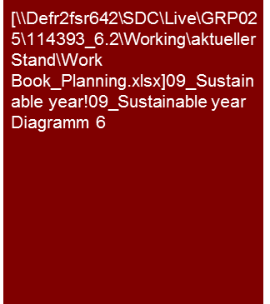
1. When is the planning horizon to be extended? (1/2)
Sustainable Result (income)/Terminal Value
For the phase of the perpetual annuity we extended the planning period by x years, taking into consideration the cyclical business model of XXX AG and the current market trends, so as to consider the entire cycle. Based on this we established a sustainable average attainable sales level of €xxx million.
Cyclical company
Cyclical business model
The XXX AG shows highly fluctuating sales and profits depending on the economic cycle.
In determining the terminal value the cyclicality of the business model of XXX AG is to be considered. In addition the long-term trends in which the individual cycles move are also to be considered.
To reproduce an entire cycle, we have extended the planning period of the XXX AG by x years; we made the following assumptions:[XXX]
In view of the sales developments observed in the analysis period we considered an average sales level of €x million determining the terminal value.
Growth company
The planning years 2010 to 2012 are, as a result of the start-up character of XXX AG, above the peer group average sales growth and below the peer group average EBIT margins.
To reproduce a sustainable income in terms of a steady state, we extended the planning for XXX AG by a rough planning phase for the years 2013 to 2015.
We assume that, as a result of the entry of other competitors and the associated limitation of the expected expansion of market share in the planning phase, the growth of XXX AG at the end of the rough planning phase will get close to the average sales growth of the peer group and therefore the general market growth.
Declining start-up losses and successively increasing utilization of capacity lead to an increase in the EBIT margin in the rough planning phase. Sustainably we assume, on the basis of the slightly worse regional sales mix compared to the peer group, an EBIT margin slightly below the peer-group average.
(Young) Growth company
Actual
Plan
Tools
Excel analysis
Appropriate presentation(s) for profit parameter(s)

Slide 8

1. When is the planning horizon to be extended? (2/2)
Sustainable Result (income)/Terminal Value
We expect that as a result of the long-term increasing price competition resulting from the market entry of competitors, the EBIT margin of the XXX AG will stabilize within the range of its peer group, but on the upper end.
Excess returns/Underperformance
Temporary advantage
The XXX AG has generated, as a result of its first-mover advantage and the associated monopoly in the field of xxxx in the planning period, an EBIT margin above the comparable margins of the peer group.
As a result of the relatively rigid demand of its customers the XXX AG is currently able to assert correspondingly high prices in the market.
The planned market entry of YYY AG in 2013 will lead to a noticeable pressure on prices. To protect its market share the XXX AG will also have to accept the corresponding price cuts, which will successively lead to decreases in EBIT margins till 2015 and is reproduced through the added rough planning phase 2013 to 2015.
As a result of the lack of innovative product developments in the planning period, we assume that the XXX AG EBIT margin will stabilize within the range of the peer group. With the significantly increased sales level from the market share obtained, we expect economies of scale that will lead to the sustainable EBIT margin stabilizing above the peer-group average.
Temporary disadvantage
As a result of the poorly negotiated purchasing agreement of the XXX AG, the XXX AG expects EBIT margins below the range observed for the peer group in the planning period.
With the end of the agreement at the end of the detail planning phase in 2012, the company assumes successively improved purchasing conditions with alternative suppliers. To reproduce these positive effects, we have extended the planning horizon by means of a rough planning phase until 2015.
Sustainably we assume that the XXX AG will manage to generate an EBIT margin comparable to the peer group.
Tools
Excel analysis

Slide 9

2. On what is a suitable sustainable operative level of profit oriented? (1/2)
Sustainable Result (income)/Terminal Value
On the basis of XXX, we considered sustainable sales of €X million.
Sustainable level of sales
Sustainable level of sales
The derivation of the sustainable sales was performed based on the sales development in the planning period connected with an analysis of the relevant value and risk drivers as well as the expected market developments of the individual regions/segments, etc., in which the XXX AG is active.
The market for XXX relevant for the XXX AG is currently in XXX and in the future XXX. The XXX AG has, with a market share of x.x %, an excellent market position. As a result of the extremely competitive market environment, we do not foresee a sustainable significant shift of the market share relationships.
We expect that the sustainable sales in region/segment, etc. will be marked by XXX. To become less dependent on the volatilities of the segment XXX, a higher sales percentage of segment XXX was assumed in the long term.
In view of this and in expectation of future XXX we have, in consideration of regional estimates, set the sustainable level of sales at € XX.X million.
Actual
Plan
Cyclical company
Tools
Excel analysis

Slide 10

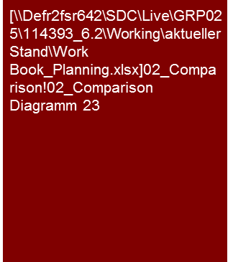
2. On what is a suitable sustainable operative level of profit oriented? (2/2)
Sustainable Result (income)/Terminal Value
Assuming XXX we consider a sustainable EBITDA margin of X% and a sustainable EBITDA of €X million to be appropriate.
Sustainable EBIT margin
Sustainable EBIT margin
The XXX measures expected in the course of XXX will continue to exercise high pressure on the gross profit margins. The already very high competitive intensity will display itself in continued declining gross profit margins, especially in view of the weakening sales growth in the future.
To obtain the critical level of sales needed for economies of scale in the future as well, this will continue to be, for the most part, with discount strategies and the associated reduction in the margins.
We assume that the XXX AG, on the basis of its advantageous regional diversification and its absolute size, will continue to succeed in maintaining its gross profit margin at a stable level and have considered a sustainable gross profit margin of x.x%.
Future efficiency increasing measures and taking advantage of other opportunities in the XXX will not be able to completely compensate for the inflation-based profit margin decreases expected. We therefore assume a sustainable EBITDA margin level of x.x %, which is above the EBITDA margins of the recent past, but still below the planned EBITDA margin.
Peer group comparison
The sustainable EBITDA margin of x.x% is within the range of comparable companies established in the market.
Sustainable EBITDA margin in comparison to peers
Tools
Excel analysis

Slide 11
3. What is a suitable reinvestment ratio?
Sustainable Result (income)/Terminal Value
Under consideration of XXX we expect a sustainable investment level of €X million and an investment ratio of x%.
Sustainable investment level
Sustainable investment level
The assets required to achieve the sustainable result/income are regularly identified by a finite economic life and therefore reinvestments must be made in continuous intervals.
Under consideration of the current structure of the fixed assets of XXX AG, the expansion of capacity plausible for the profit growth planned in the planning phase and the mid-term investment cycle, we have, estimating the future replacement costs in the results of our analyses, set the sustainable reinvestment level at XXX.
The sustainable investment ratio of X.X% based on the sales earnings, is below the investment ratios shown in the past and the planning phase, which were mainly influenced impacted by the expansion of capacity and the elimination of the investment backlog. In contrast to the past and the planning phase the sustainable investment level considers only reinvestments.
Peer group comparison
The sustainable reinvestment ratio of X.X% is within the range of comparable companies established in the market.
Actual
Plan
Note: (a) Investment ratio = Investments/net sales
Investment ratio in comparison to peer group
Actual
Plan
Tools
Excel analysis

Slide 12

4. What is a suitable level for a sustainable capital structure and a sustainable financial result?
Sustainable Result (income)/Terminal Value
In view of XXX, we consider the sustainable capital structure of XXX to be appropriate.
Under consideration of sustainable borrowing rate and earned interest rate of X% and Y%, respectively, the sustainable interest result is €X million.
We derived the sustainable income from participations on the basis of XXX.
The result is an appropriate sustainable financial result of €X million.
Capital structure in comparison to peer group
Capital structure and financing conditions
As a result of the pay-out limitations of the current credit line of XXX AG, the complete retention of the group profit was reproduced to the planning years 2010 to 2013. The retained profits serve to a significant part for the return to the net financial position, which leads to a declining degree of debt and therefore declining costs of debt in the planning period.
The target level of debt at XXX AG will be achieved toward the end of the planning horizon, so that as of planning year 2014 sqq. a pay-out ratio of 40% is assumed. The level of debt and the pay-out ratio are oriented on the parameters observed for the peer group.
The sustainable cost of debt of x% correspond with the sustainable level of debt considered by XXX AG and correspond to a long-term rating of xxx.
Actual
Plan
Tools
Excel analysis

Slide 13
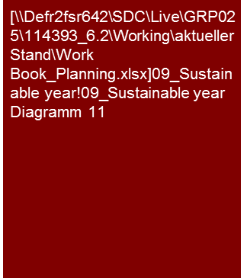
5. What is a suitable level for a sustainable tax burden?
Sustainable Result (income)/Terminal Value
Under consideration of regional shifts, the local tax rates and the tax losses carried forward still existing at the end of the planning horizon, the sustainable tax rate is 29.4%.
Sustainable tax rate
For the calculation of the sustainable tax rate, the trade tax, corporate tax and the solidarity tax in accordance with the currently applicable tax system as well as foreign income tax on the basis of the long-term expected regional profit mix were considered.
For the determination of the tax assessment base and the income taxes significant deviations between tax result under IFRS and according to the tax balance sheet, tax loss carryforwards as well as regional tax regulations were considered.
At the end of the planning horizon there is still a corporate tax loss carried forward of €X million and tax losses carried forward in xxx of €X million. We considered these in the form of an annuity in the derivation of the sustainable tax burden.
The result is a sustainable effective tax rate of 29.4%. This is, as a result of the high percentage of profit and the relatively high effective tax rate, primarily determined by France.
Tools
Excel analysis

Slide 14
© 2017 KPMG International Cooperative (“KPMG International”). KPMG International provides no client services and is a Swiss entity with which the independent member firms of the KPMG network are affiliated.

